Slide 1
PROJECT TITLE: Secure Data Hiding in Image Using Steganography
CAPSTONE PROJECT
Presented By:
Student Name : PRABHAT BARNWAL
College Name & Department : PRODUCTION ENGINEERING, NIT AGARTALA

Slide 2
OUTLINE
Problem Statement
Technology used
Wow factor
End users
Result
Conclusion
Git-hub Link
Future scope

Slide 3
Problem Statement
In today's digital age, the need for secure communication and data protection has never been greater. Traditional encryption methods, while effective, can be easily detected and may attract unwanted attention.
Steganography, which involves hiding data within digital images, makes the existence of the hidden data virtually undetectable.
This project aims to develop an advanced steganographic method for securely hiding data within images, ensuring that the hidden data remains undetectable, while maintaining the quality and integrity of the host image.

Slide 4
Technology used
LIBRARIES:
cv2: The cv2 library of Python is part of OpenCV (Open Source Computer Vision Library), which is a popular open-source library for computer vision and image processing tasks.
os: The os library in Python provides a way to interact with the operating system.
Platforms:
Microsoft VSCode: Microsoft Visual Studio code (VSCode) is a free, open-source code editor that is highly regarded for its versatility, performance, and extensive features.

Slide 5
Wow factors
Direct Mapping of ASCII characters to Pixel values: Instead of converting text to binary and embedding it in bits, this project maps each character to its ASCII value and stores it in RGB channels. This makes encryption and decryption faster and more lightweight.
Three-Channel Encoding (RGB Cycling) : The message characters are spread across the Red, Green, and Blue (RGB) channels in a cyclic manner. This makes the embedded message more distributed and less predictable compared to single-channel encoding.
Metadata Storage for Persistence: Many steganography implementations require the user to remember the message length and password. This project automatically stores metadata (passcode + message length) in a separate file (metadata.txt), reducing human error.
Standalone Encryption and Decryption Programs: Encryption and decryption are in separate scripts, making it easy to use in different environments or even across multiple devices.

Slide 6
End users
The end users include government agencies, defense organizations, and intelligence services that need to exchange classified information securely without drawing attention.
Additionally, businesses handling sensitive data, such as financial institutions, healthcare providers, and legal firms, can benefit from this technology to safeguard proprietary information and maintain confidentiality.
Researchers and academic institutions focused on cybersecurity can also use this advanced steganographic method to develop and implement secure communication protocols.

Slide 7
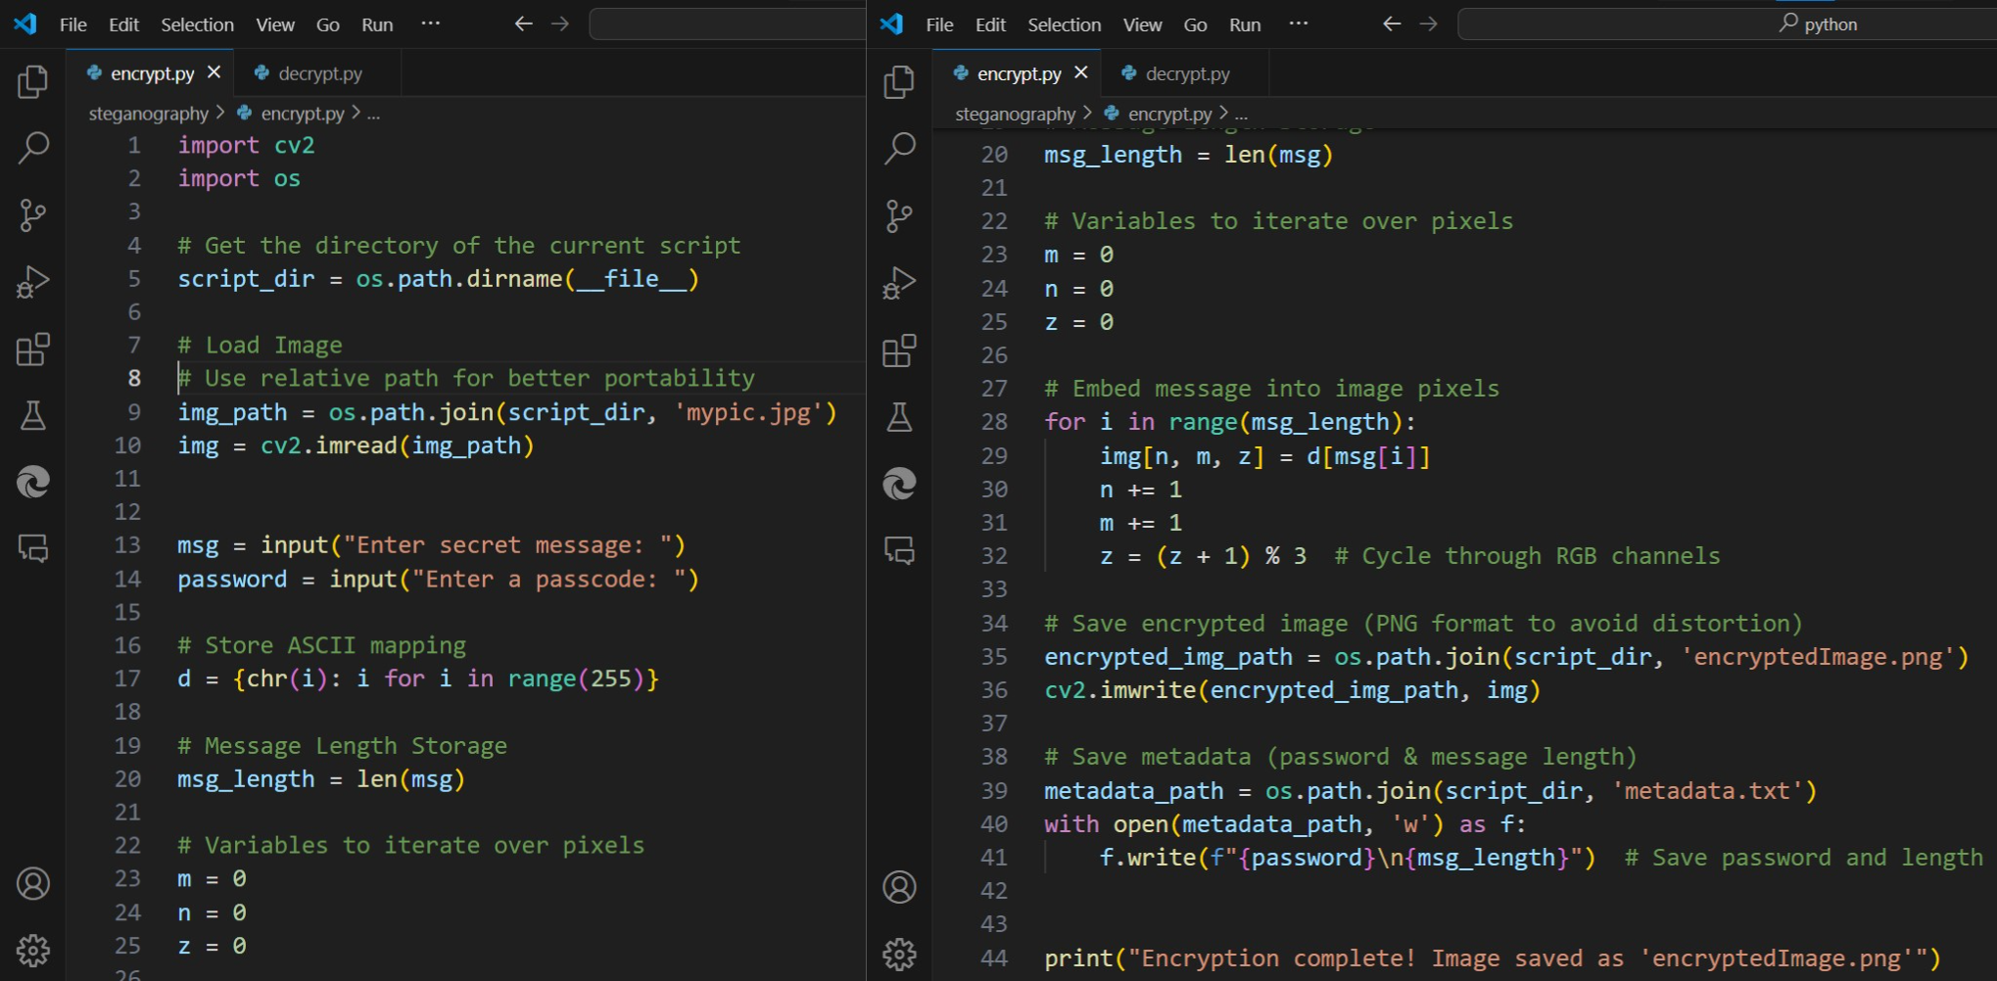
Results

Slide 8
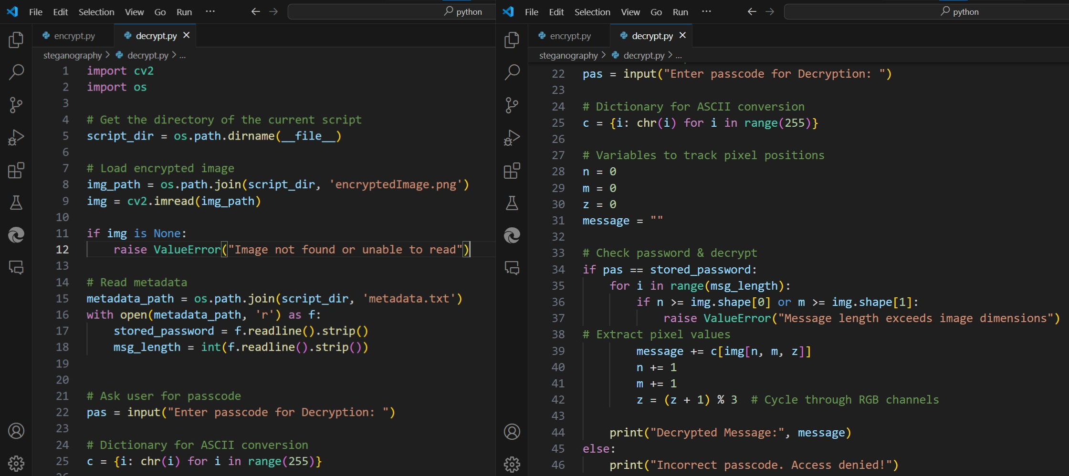
Results (continued…)

Slide 9
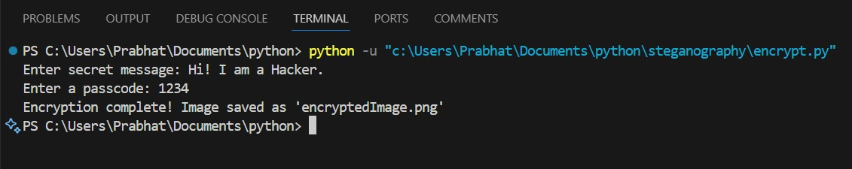
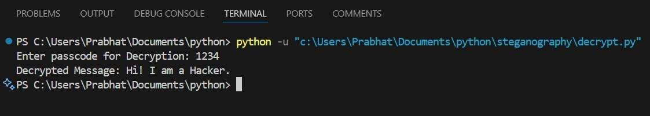
Results (continued...)

Slide 10
Conclusion
This project on secure data hiding in images using steganography offers a sophisticated approach to enhancing covert communication and data protection.
By leveraging advanced steganographic techniques, it ensures the hidden data remains undetectable while preserving the quality and integrity of the host image.
Addressing the current limitations, such as data capacity, imperceptibility, and robustness against attacks, this solution provides a more secure and reliable means of safeguarding sensitive information.

Slide 11
GitHub Link
My project can be accessed here: https://github.com/prabhatbarnwal29/project_stegno.git

Slide 12
Future scope
Some potential directions for further development and application are:
Enhanced Security Algorithms: Continued research can lead to the development of even more sophisticated steganographic algorithms that enhance security, making it harder for unauthorized parties to detect and extract hidden data.
Integration with Blockchain: Integrating steganography with blockchain technology can ensure secure and immutable transmission of sensitive information, providing an additional layer of protection and verification.
Steganography in Video: Expanding the techniques to embed data in video files can offer new avenues for secure communication, considering the popularity and extensive use of video content.

Slide 13
THANK YOU

